Slide 1
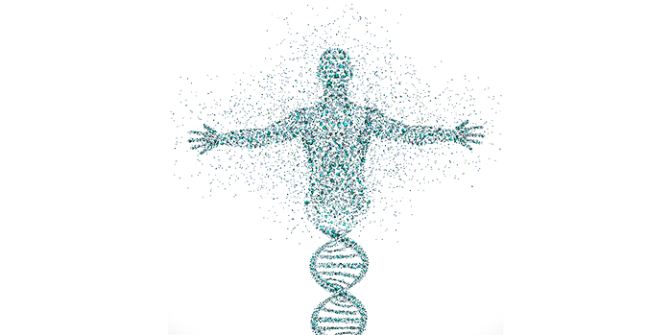
Data Science in Precision Medicine’s treatment of Oncology
By: Sabrina Riebe

Slide 2
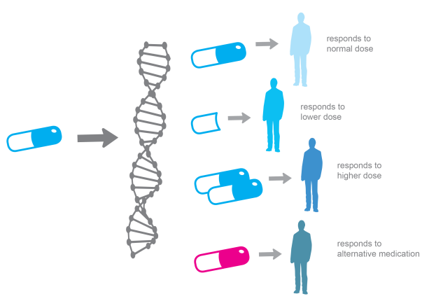
What is Precision Medicine?
Our genetic information is unique & cancers and tumors in our body have unique signatures
our bodies react differently to drugs
The promise: a world in which everyone’s health recommendations and disease treatments are tailored based on their personalized genetic information
Combines data on a patient’s genes, environment, and lifestyle
Health recommendations and disease treatments are tailored based on their medical history, genetic lineage, past conditions, diet, stress levels, and more

Slide 3

But is this new?
The potential to apply precision medicine to a range of heath and diseases – yes!
Cancer has been leading precision medicine for years
Significant strides in learning the molecular signatures of many types of cancers but there’s still lots to do
The new developments in
more affordable DNA sequencing,
availability of better methods of assessing environmental exposure,
revolution in mobile health technologies,
emergence of conceptual tools for analyzing large amounts of data

Slide 4
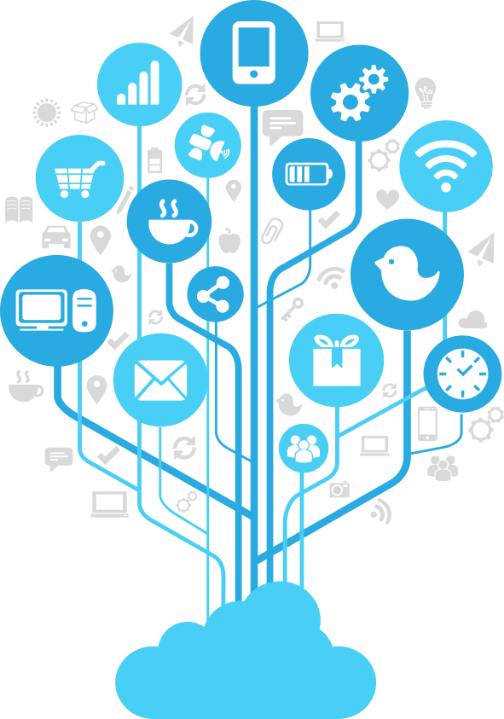
Where does data science come in?
Researchers started collecting genetic data from cancer patients and recorded their responses to drugs and chemicals
Sources of data:
IoT – wearables (heart rate, BP, weight, activity levels, stress levels), apps (exercise regimen and intensity, amount and quality of sleep), medical devices and sensors (number of vital signs on a continuous basis)
Insurance providers
Clinical data
Opt-in genome and research registries
Social media (person’s health, mood, state of mind)
Web knowledge (less patient specific)

Slide 5
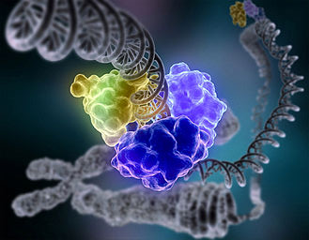
Data Science continued…
Capacity to
detect the onset of cancer at its earliest stages,
preempt the progression of the disease,
increase the efficiency of the healthcare system by improving the quality, accessibility, and affordability
Data science methods of Support Vector Machine (SVM) and Recursive Feature Elimination (RFE) were applied to predict personalize drug responses

Slide 6
Where are we now?
Establishment of a “cancer knowledge network”
fuel scientific discovery and guide treatment decisions, and accelerate the design and testing of more precisely targeted therapies
Understand mechanisms for drug resistance, explore new combination therapies aimed at specific tumor mutations, and develop non-invasive ways to track how patients respond to targeted treatments
Minor or harmful long-term side effects cannot be captured in clinical trials
Volunteers needed
MIT Center for Precision Cancer Medicine (CPCM)
Might eventually apply to minor conditions, it’s likely to make much of its initial impact in high stakes situations i.e. chemotherapy

Slide 7
References
https://www.techemergence.com/where-healthcares-big-data-actually-comes-from/
https://www.techemergence.com/machine-learning-healthcare-applications/
https://www.news-medical.net/news/20180122/Promoting-precision-medicine-using-data-science-of-large-datasets.aspx
https://www.datacamp.com/community/blog/breakthroughs-big-data-science-2017
http://www.futureofpersonalhealth.com/education-and-research/how-precision-medicine-is-changing-health-care
https://siliconangle.com/blog/2018/01/22/can-precision-medicine-break-chokehold-on-healthcare-big-data-reinvent-womenintech/
https://www.statnews.com/2018/02/23/precision-medicine-community-providers/

